Slide 1

DISSERTATION
HSTDS6043D
ROBUSTNESS OF t-test
Shreya Saha (442)
Registration No. : A01-2122-0855-21
Supervisor : Dr. Surupa Chakraborty (Roy)
St. Xavier’s College (Autonomous),Kolkata
ROBUSTNESS OF t-test
MAY 03, 2024 1

Slide 2
DISSERTATION
HSTDS6043D
Background
t-test is widely used statistical tool offering practical significance in various research fields, especially when the sample size is sufficiently small. It compares the sample and hypothesized mean value and tells us whether their difference is statistically significant.
Motivation & Objective of Study
We use Student’s t-test or one sample t-test when the parent distribution is assumed to be normal. But, we may not always provided with the data which will follow normal distribution. Now, suppose it is non-normal distribution and we still perform t-test forcefully. Thus, our objective is to check whether t-test is robust under this situation and if yes, what is the implication.
ROBUSTNESS OF t-test
MAY 03, 2024 2

Slide 3
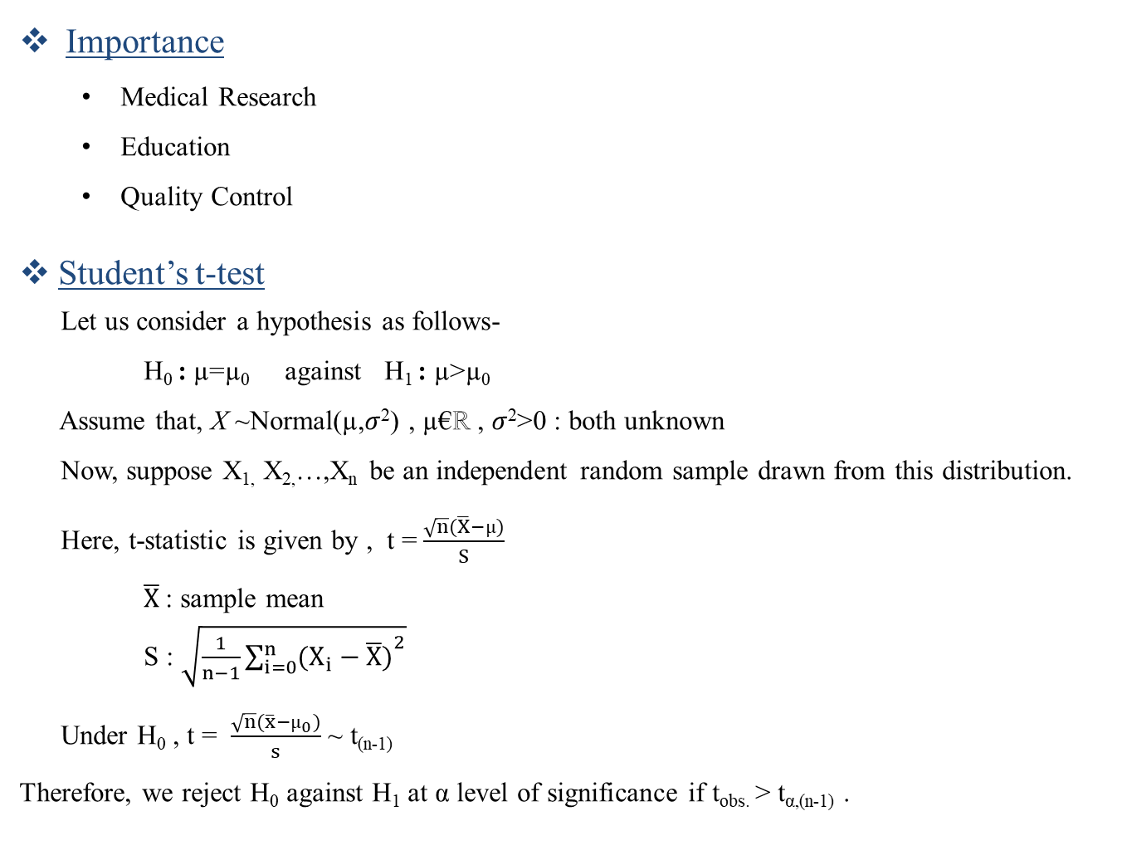
DISSERTATION
HSTDS6043D
Importance
Medical Research
Education
Quality Control
Student’s t-test
Let us consider a hypothesis as follows-
H₀ : µ=µ₀ against H₁ : µ>µ₀
Assume that, X ~Normal(µ,$σ$²) , µ€ℝ , $σ$²>0 : both unknown
Now, suppose X_{1,} X_{2,}…,X_{n} be an independent random sample drawn from this distribution.
Here, t-statistic is given by , t = $\frac{\sqrt{n}(\overline{X}−µ)}{S}$
$\overline{X}$: sample mean
S : $\sqrt{\frac{1}{n−1}{\sum_{i=0}^{n}{(X_{i}−\overline{X})}}^{2}}$
Under H₀ , t = $\frac{\sqrt{n}(\overline{x}−µ_{0})}{s}$ ~ t_{(n-1)}
Therefore, we reject H₀ against H₁ at α level of significance if t_{obs.} > t_{α,(n-1)} .
ROBUSTNESS OF t-test
MAY 03, 2024 3

Slide 4
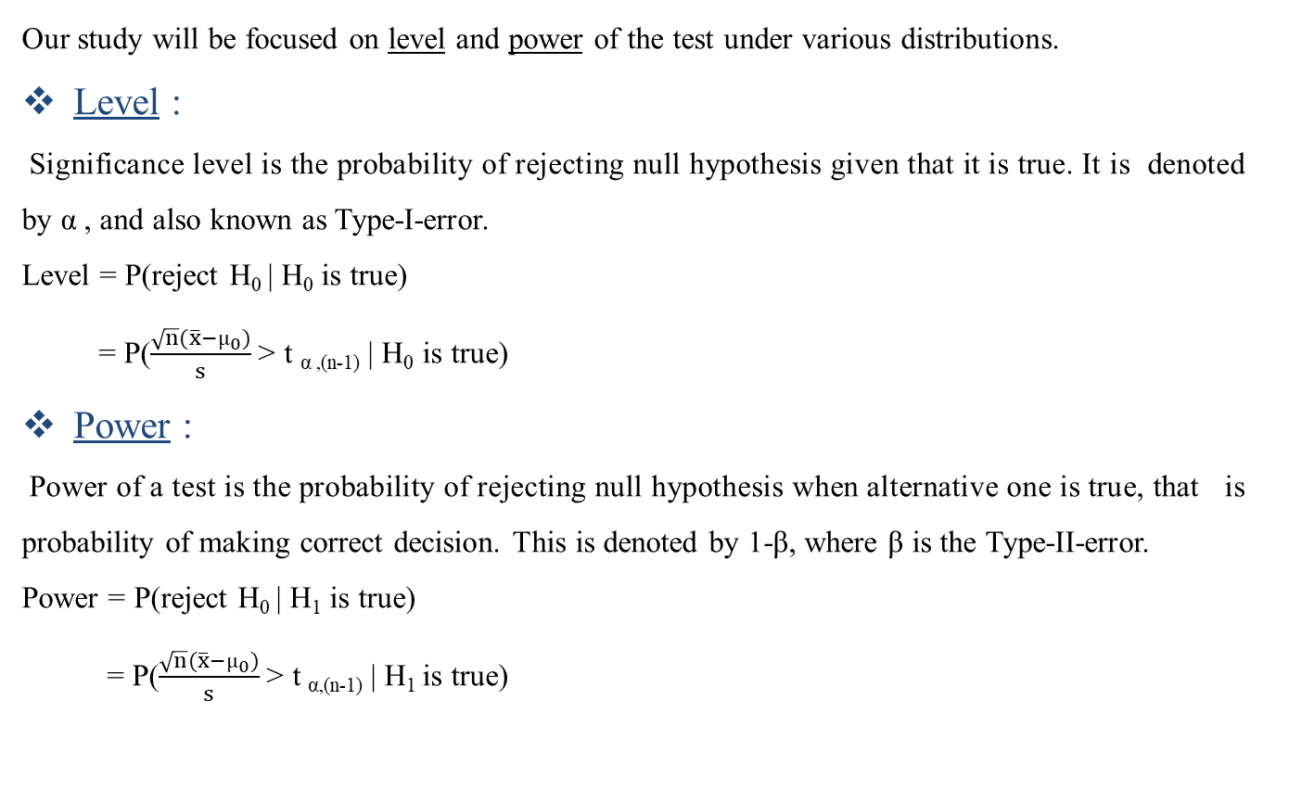
DISSERTATION
HSTDS6043D
Our study will be focused on level and power of the test under various distributions.
Level :
Significance level is the probability of rejecting null hypothesis given that it is true. It is denoted by α , and also known as Type-I-error.
Level = P(reject H₀ | H₀ is true)
= P($\frac{\sqrt{n}(\overline{x}−µ_{0})}{s}$> t _{α ,(n-1)} | H₀ is true)
Power :
Power of a test is the probability of rejecting null hypothesis when alternative one is true, that is probability of making correct decision. This is denoted by 1-β, where β is the Type-II-error.
Power = P(reject H₀ | H₁ is true)
= P($\frac{\sqrt{n}(\overline{x}−µ_{0})}{s}$> t _{α,(n-1)} | H₁ is true)
ROBUSTNESS OF t-test
MAY 03, 2024 4

Slide 5
DISSERTATION
HSTDS6043D
Simulation based study under t-test
To avoid any error due to sampling in between the data, we shall be using random seed = 1234 in R to generate the data.
Generate a sample of size n=20.
Let the sample is denoted by X₁, X₂, …,X₂₀ drawn from a population distribution having cdf F_{x.}
We repeat this procedure 1000 times.(Here we will consider some population distributions just to generate the sample observations.)
In this study we will consider right tailed test only. So, we fix the hypothesis as-
H₀ : µ=1 against H₁ : µ=2
We will choose the value of parameters of each distribution such a way that the population mean under null hypothesis is 1 and the same under alternative is 2.
Consider the level of significance as 0.05.
We continue this procedure for each population distribution.
As we consider simulation based study, we will obtain empirical level (proportion of times null hypothesis gets rejected when the sample is drawn from H₀ ) and empirical power (proportion of times null hypothesis gets rejected when the sample is drawn from H₁ ).
ROBUSTNESS OF t-test
MAY 03, 2024 5

Slide 6
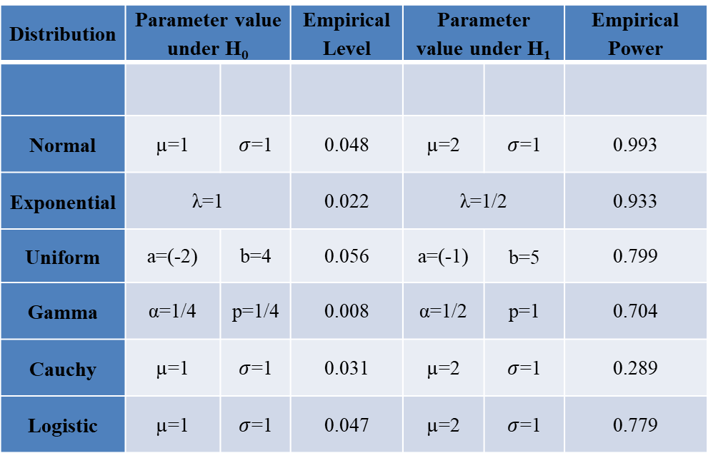
DISSERTATION
HSTDS6043D
Comparison under t-test
Here we try to find out whether t-test is applicable for normal as well as non-normal data, i.e, how much t-test is robust. To study this, we run a simulation study.
Findings
Distribution | Parameter value under H₀ |  | Empirical Level | Parameter value under H₁ |  | Empirical Power
Normal | µ=1 | $σ$=1 | 0.048 | µ=2 | $σ$=1 | 0.993
Exponential | λ=1 |  | 0.022 | λ=1/2 |  | 0.933
Uniform | a=(-2) | b=4 | 0.056 | a=(-1) | b=5 | 0.799
Gamma | α=1/4 | p=1/4 | 0.008 | α=1/2 | p=1 | 0.704
Cauchy | µ=1 | $σ$=1 | 0.031 | µ=2 | $σ$=1 | 0.289
Logistic | µ=1 | $σ$=1 | 0.047 | µ=2 | $σ$=1 | 0.779
ROBUSTNESS OF t-test
MAY 03, 2024 6

Slide 7
DISSERTATION
HSTDS6043D
Power Curves
Here we consider some values of µ, calculate the corresponding power and plot them to get the power curves underlying to the previously chosen distributions.
ROBUSTNESS OF t-test
MAY 03, 2024 7

Slide 8

DISSERTATION
HSTDS6043D
Non-parametric test
For non-normal data, we should not implement t-test as per its assumptions. In that case, non- parametric tests should give reliable results because -
It does not take into account any parametric assumptions
It deals about the form of the population
Hence our focus will be to observe how non-parametric test will perform for non-normal parent distributions.
Sign Test
non-parametric test analogous to Student’s t-test
test for location parameter in terms of median
General Idea
Consider the hypothesis as follows-
H₀ : θ_{p} = θ_{p}⁰ against H₁ : θ_{p} > θ_{p}⁰
where, θ_{p}=θ_{p}(F) be the p^{th} quantile of the distribution i.e.,P_{F}(X$≤$ θ_{p}) = p
ROBUSTNESS OF t-test
MAY 03, 2024 8

Slide 9
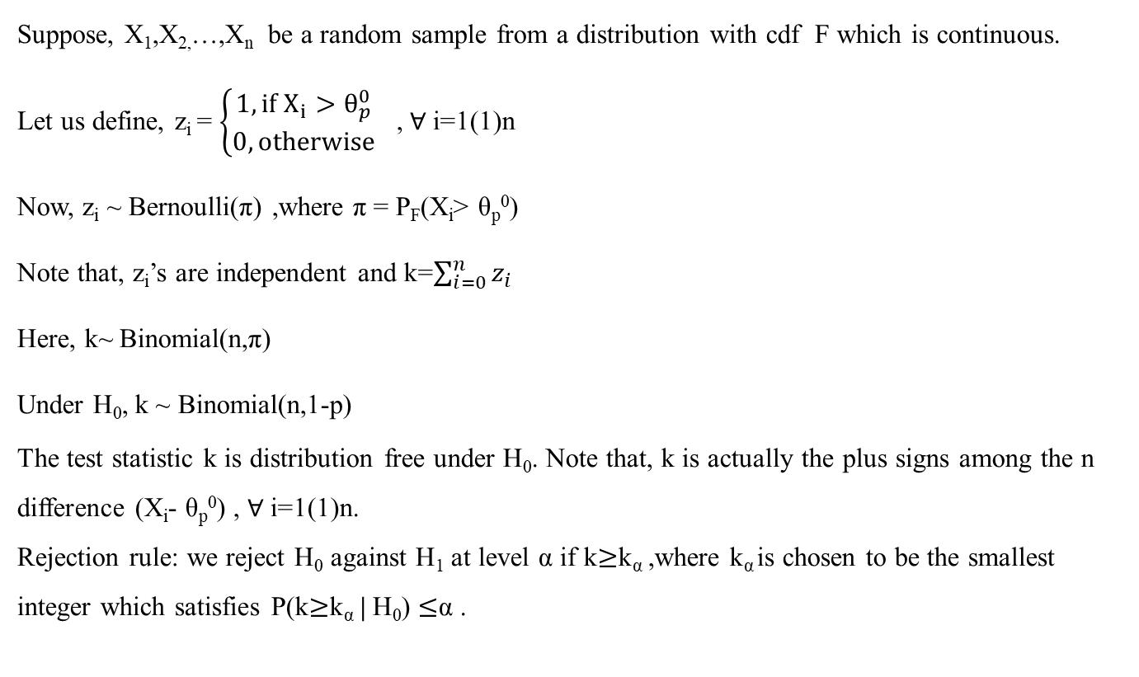
DISSERTATION
HSTDS6043D
Suppose, X₁,X_{2,}…,X_{n} be a random sample from a distribution with cdf F which is continuous.
Let us define, z_{i} = $\left\{\begin{aligned}1, if X_{i}>θ_{p}^{0} \\ 0, otherwise\end{aligned}\right.$ , $∀$i=1(1)n
Now, z_{i} ~ Bernoulli(π) ,where π = P_{F}(X_{i}> θ_{p}⁰)
Note that, z_{i}’s are independent and k=$\sum_{i=0}^{n}{z_{i}}$
Here, k~ Binomial(n,π)
Under H₀, k ~ Binomial(n,1-p)
The test statistic k is distribution free under H₀. Note that, k is actually the plus signs among the n difference (X_{i}- θ_{p}⁰) , $∀$i=1(1)n.
Rejection rule: we reject H₀ against H₁ at level α if k$≥$k_{α} ,where k_{α} is chosen to be the smallest integer which satisfies P(k$≥$k_{α} | H₀) $≤$α .
ROBUSTNESS OF t-test
MAY 03, 2024 9

Slide 10
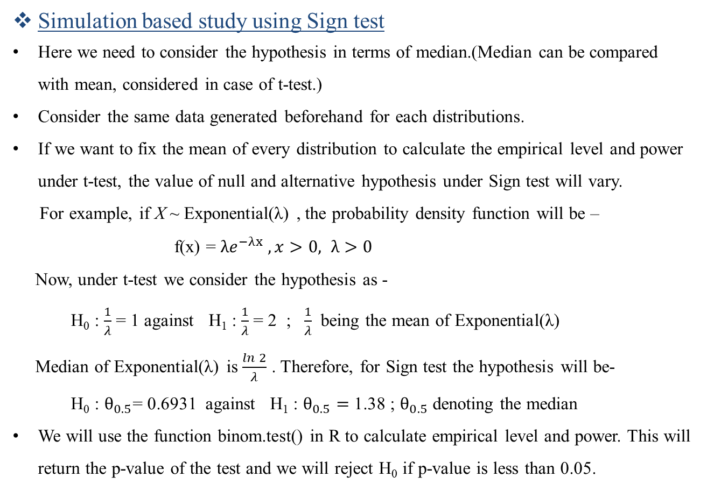
DISSERTATION
HSTDS6043D
Simulation based study using Sign test
Here we need to consider the hypothesis in terms of median.(Median can be compared with mean, considered in case of t-test.)
Consider the same data generated beforehand for each distributions.
If we want to fix the mean of every distribution to calculate the empirical level and power under t-test, the value of null and alternative hypothesis under Sign test will vary.
For example, if X ~ Exponential(λ) , the probability density function will be –
f(x) = $λe^{−λx} , x>0, λ>0$
Now, under t-test we consider the hypothesis as -
H₀ : $\frac{1}{λ}$ = 1 against H₁ : $\frac{1}{λ}$ = 2 ; $\frac{1}{λ}$ being the mean of Exponential(λ)
Median of Exponential(λ) is $\frac{\ln{2}}{λ}$ . Therefore, for Sign test the hypothesis will be-
H₀ : $θ_{0.5}$= 0.6931 against H₁ : $θ_{0.5}=$ 1.38 ; $θ_{0.5}$ denoting the median
We will use the function binom.test() in R to calculate empirical level and power. This will return the p-value of the test and we will reject H₀ if p-value is less than 0.05.
ROBUSTNESS OF t-test
MAY 03, 2024 10

Slide 11
DISSERTATION
HSTDS6043D
Comparison under Sign test
Here we try to find out whether Sign test will give better results for non-normal data. That is, we will compare which test is applicable for underlying parent distributions.
Findings
Distribution | Empirical Level | Empirical Power
Normal | 0.013 | 0.908
Exponential | 0.012 | 0.440
Uniform | 0.019 | 0.286
Gamma | 0.021 | 0.978
Cauchy | 0.016 | 0.623
Logistic | 0.019 | 0.535
ROBUSTNESS OF t-test
MAY 03, 2024 11

Slide 12
DISSERTATION
HSTDS6043D
 | t-test |  | Sign Test
Distribution | Empirical Level | Empirical Power | Empirical Level | Empirical Power
Normal | 0.048 | 0.993 | 0.013 | 0.908
Exponential | 0.022 | 0.933 | 0.012 | 0.440
Uniform | 0.056 | 0.799 | 0.019 | 0.286
Gamma | 0.008 | 0.704 | 0.021 | 0.978
Cauchy | 0.031 | 0.289 | 0.016 | 0.623
Logistic | 0.047 | 0.779 | 0.019 | 0.535
ROBUSTNESS OF t-test
MAY 03, 2024 12

Slide 13
DISSERTATION
HSTDS6043D
t-test giving better result ,i.e. ,meets the assumption of t-test
Power curves
Violates the law of t-test
Still giving better result using it
i) Normal Distribution :
ii) Exponential Distribution :
ROBUSTNESS OF t-test
MAY 03, 2024 13

Slide 14
DISSERTATION
HSTDS6043D
iii) Uniform Distribution :
iv) Gamma Distribution :
ROBUSTNESS OF t-test
MAY 03, 2024 14

Slide 15
DISSERTATION
HSTDS6043D
Location parameter is median
Sign test should give better result
v) Cauchy Distribution :
vi) Logistic distribution :
ROBUSTNESS OF t-test
MAY 03, 2024 15

Slide 16
DISSERTATION
HSTDS6043D
Conclusion:
Comparing all the findings throughout the study, we observe that -
t-test is not only applicable for normally distributed data , rather for Exponential, Uniform, Logistic distributions also.
Sign test is giving adequate result for Gamma distribution and Cauchy distribution.
Sometimes, t-test is also suitable for testing the hypothesis about mean of a single sample following some non-normal distributions though the parametric assumptions are violated.
That is, sometimes t-test is robust to the deviation of normality and moderate violation of assumptions.
ROBUSTNESS OF t-test
MAY 03, 2024 16

